Slide 1

UNIVERSITY OF MESSINA
Department
Cognitive Science and Theory of Communication – LM-55
Course Title
SOCIAL SEMIOTICS
Teacher
Maria Rita Bartolomei
Mail: mabartolomei@unime.it

Slide 2

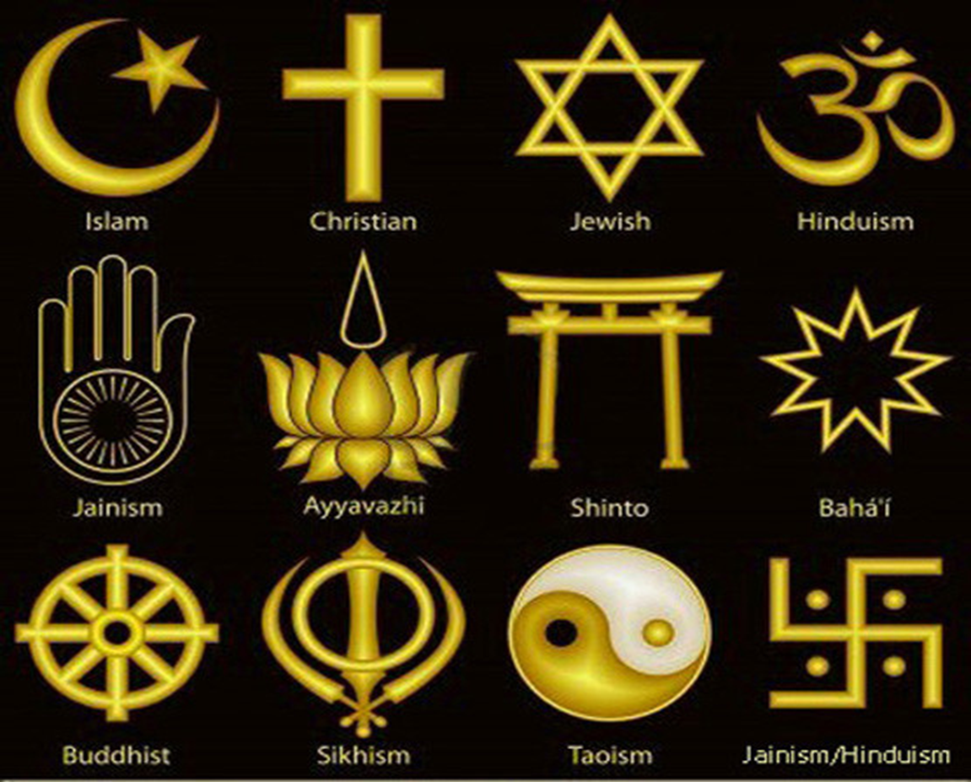
SOCIAL SEMIOTICS
Semiotics
of the sacred

Slide 3

SOCIAL SEMIOTICS
Sacred and ritual
The sacred is
a complex composite notion
a structural analytical concept
a transcendent reality which man experiences
a force which is found
- in each totemic object – mana
- in every aspect of natural and supernatural reality
Tree of life

Slide 4

SOCIAL SEMIOTICS
Sacred and ritual
Sacred vs. profane
Sacred things
are protected and isolated by prohibitions
Profane things
are those to which such prohibitions apply
which must keep their distance from what is sacred
The Caduceus

Slide 5
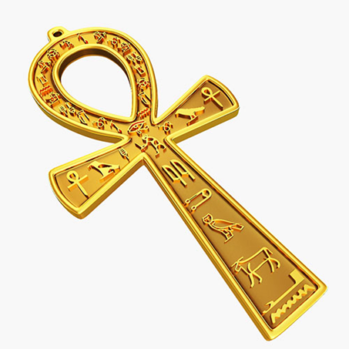
SOCIAL SEMIOTICS
Sacred and ritual
Durkheim and the nature of the sacred
Malinowski and the distinction between religion and common sense
Freud and the similarity between personal and collective rituals
Weber and the problem of meaning in the face
of analytical, emotional and moral impotence
The Ankh, or Crux Ansata

Slide 6

SOCIAL SEMIOTICS
Sacred and ritual
Religion is a human universal
although not all men are religious
there is no human society in which
the cultural models which we can call
religious are totally lacking
The spiral
universal symbol of Sacred Geometry
synthesises form and movement and contains the concept of “πάντα ῥεῖ”

Slide 7
SOCIAL SEMIOTICS
Sacred and ritual
Clifford Geertz depicted
Religion as a cultural system
a historically transmitted pattern of meanings embodied
in symbols
societies use these symbols to express their worldview,
value-orientation, ethos and other aspects of their culture

Slide 8
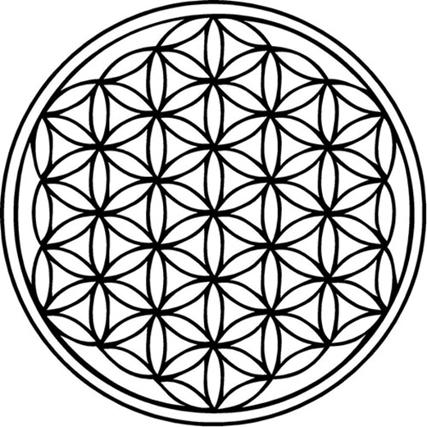
SOCIAL SEMIOTICS
Sacred and ritual
The sacred symbols
summarise the vision of the life of a people
express basic consistence between
a particular lifestyle
specific metaphysics
Flower of life

Slide 9

SOCIAL SEMIOTICS
Sacred and ritual
Sacred symbols can be considered
A model for
A model of
Religious symbols are cultural patterns
which contain both these aspects
they express the world and shape it Double happiness symbol

Slide 10

SOCIAL SEMIOTICS
Sacred and ritual
Religion Wheel of Dharma
attributes a cosmic order to human actions
is a powerful system of role models
creates deep and widespread moods and motivations
formulates a set of concepts which provide general order
to existence

Slide 11
SOCIAL SEMIOTICS
Sacred and ritual
Religion
offers a criterion
to interpret the chaos and explain what appears incomprehensible
to express, understand and endure suffering, illness, death
provides an effective set of rules and ethical criteria
which guide action in the face of evil

Slide 12
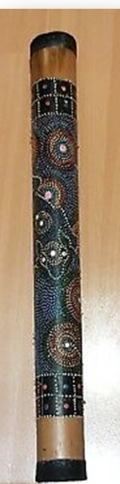
SOCIAL SEMIOTICS
Sacred and ritual
Rituals
are not necessarily religious
are a repetition of gestures and words which have
a performative character
they express, signify and effect change in the world
Rain stick

Slide 13
SOCIAL SEMIOTICS
Sacred and ritual
Rituals are ceremonial forms which
reinforce beliefs and moods
summarise the world as it is experienced and the world as it is imagined

Slide 14
SOCIAL SEMIOTICS
Sacred and ritual
Sacrifice is a universally widespread religious rite
an object is offered to a divinity in order to establish, maintain,
or restore the correct relationship of a human being or community
with the sacred order
the profane communicates with the sacred through
the intermediation of a victim

Slide 15
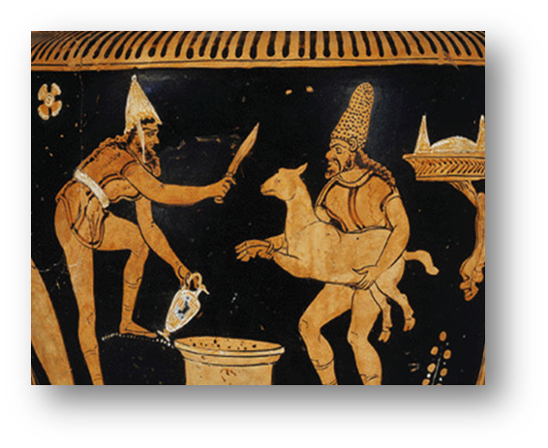
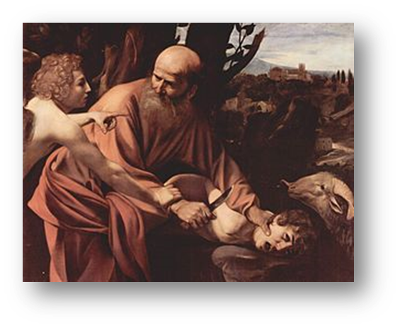
SOCIAL SEMIOTICS
Sacred and ritual
Sacrifice is a complex phenomenon which has been found in the earliest known forms of worship and in all parts of the world

Slide 16
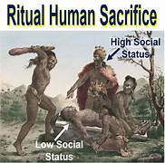
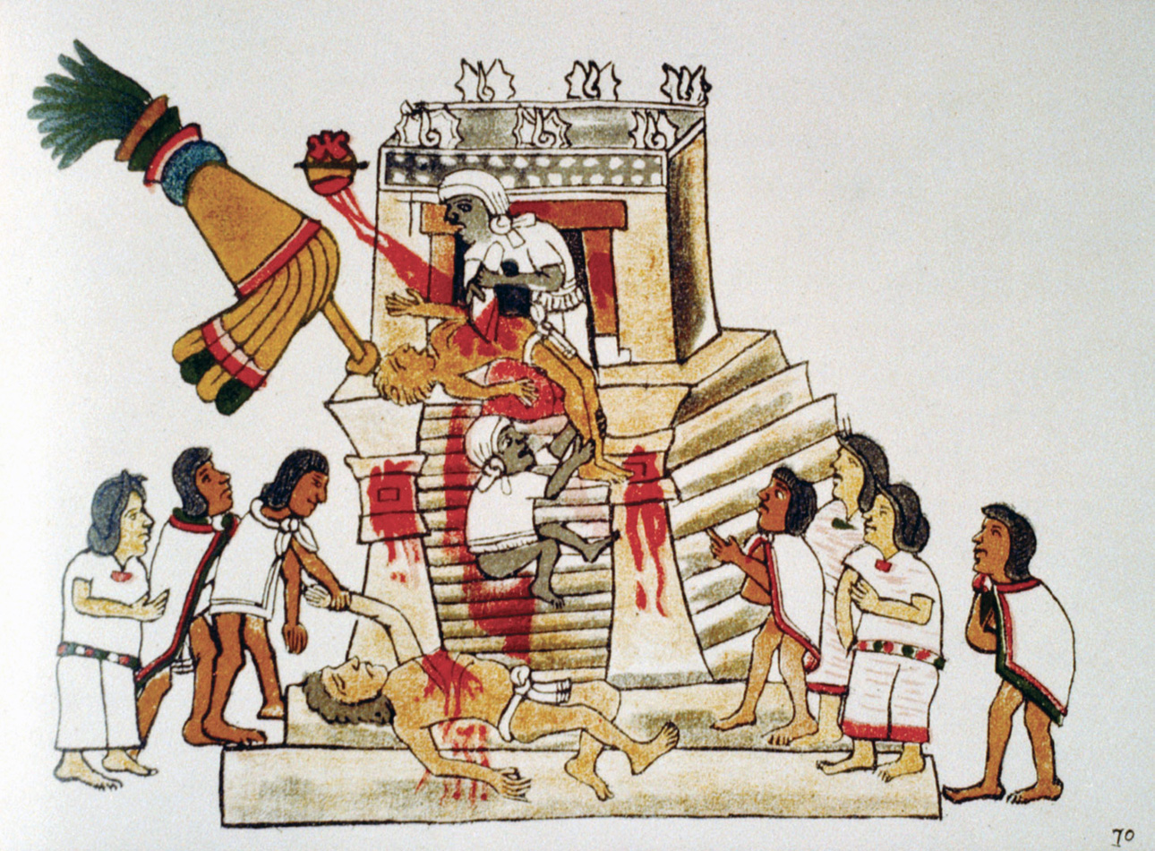
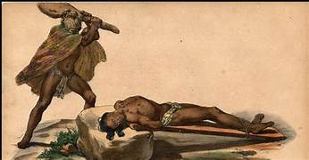
SOCIAL SEMIOTICS
Sacred and ritual
Many types of sacrifices were practised in traditional societies
Even ritual human sacrifice

Slide 17
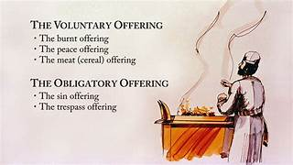
SOCIAL SEMIOTICS
Sacred and ritual
Every sacrificial rite has the purpose of creating
a relationship between two polar terms
the sacrifyer or sacrificed
the deity
a bond is created between
the victim and the beneficiary of the sacrifice

Slide 18
SOCIAL SEMIOTICS
Sacred and ritual
A social semiotics approach deals with
the set of meanings embodied in rituals
the connection of this set to social, cultural
and psychological processes

